Slide 1
What the Research Says:
How Deterrence and Incapacitation
Affect Crime and Recidivism
Megan Alderden, Ph.D.
Mark Powers, M.A.
Christine Devitt-Wesley, M.S.
John Maki, M.A., J.D.
11/07/26 | Illinois Criminal Justice Information Authority | <number>
Notes:
Over the last few Commission meetings you have generally discussed whether existing sentencing and administrative practices are actually “buying” more deterrence and incapacitation and consequently less crime and recidivism. This presentation is intended to provide you with information and data to show you where we currently stand. I’m going to start by talking about deterrence first, and then talk about incapacitation.

Slide 2
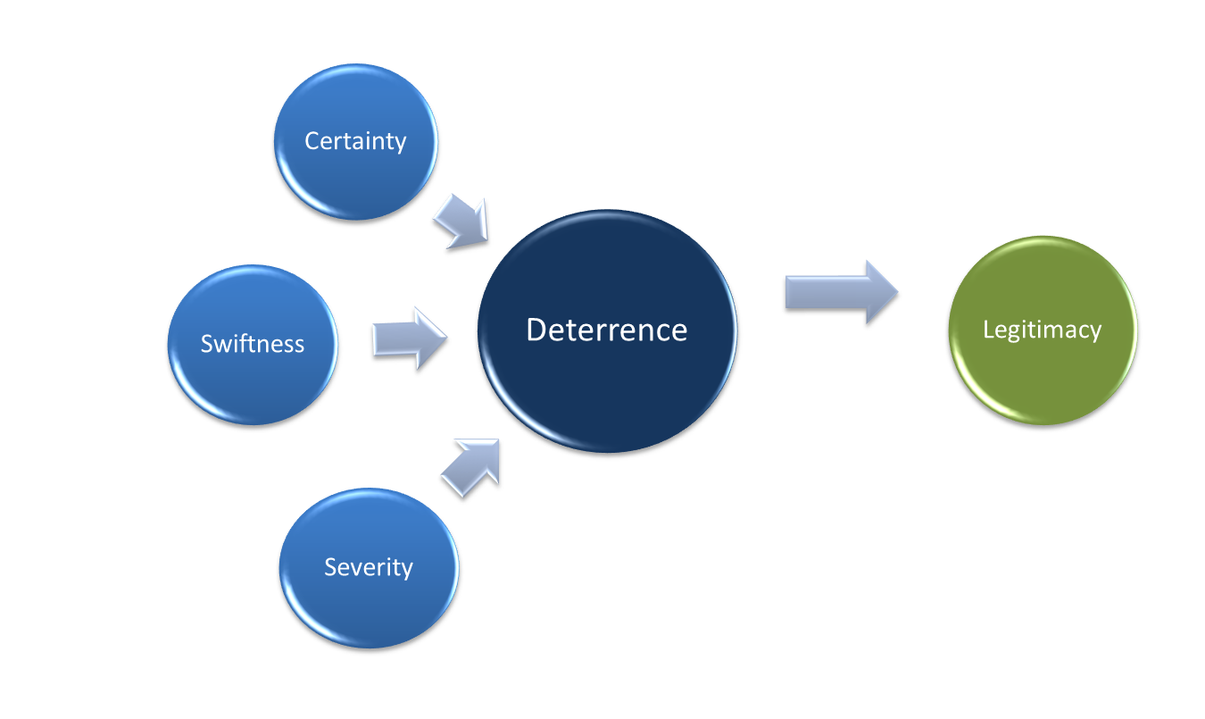

DETERRENCE
11/07/26 | Illinois Criminal Justice Information Authority | <number>
Notes:
As a society, we attempt to achieve both specific and general deterrence—general deterrence, which is aimed at preventing would-be criminals from committing crime and specific deterrence, which is punishing those who do commit crime. Another way of looking at this is that general deterrence is about the threat of punishment (general deterrence)—or telling people what will happen to them if they commit crime, while specific deterrence is about experiencing punishment when you do commit crime (specific deterrence).
How deterrence works is complicated for many reasons, some of which we will discuss today, including the fact that to some degree deterrence is based on one’s perception about whether he or she will get caught and what the punishment will be.
There are three main means by which the formal criminal justice system achieves deterrence:
certainty of punishment – or the likelihood of being punished
swiftness of punishment – or the speed at which punishment is handed out
severity of punishment
Each of the mechanisms—certainty, severity and swiftness--affects our ability to achieve deterrence in different ways and I’m going to show you data on each. More recently, criminologists have also begun to consider how we accomplish or do deterrence through these three mechanisms in turn impacts perceived legitimacy of the criminal justice system.
In turn, legitimacy of the criminal justice system also impacts our ability to achieve deterrence. When individuals no longer believe in the law or do not believe the system is fair, they may be more likely to be defiant regardless of the possibility or type of punishment.

Slide 3
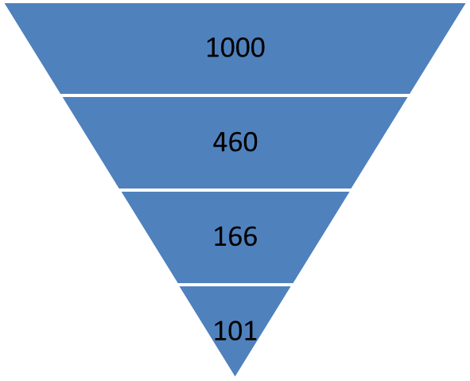
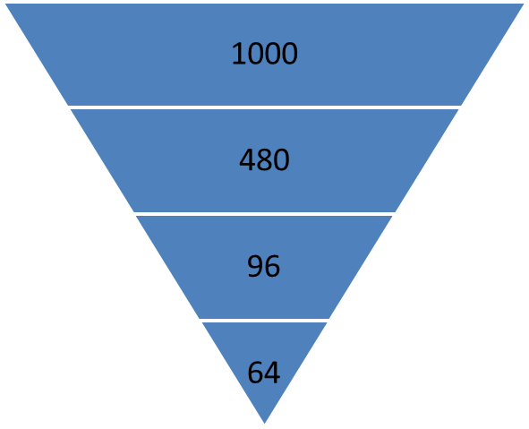
Victimizations Reported to Police^{1,}
Crimes, Identified/Arrest by Police², and Conviction³
CERTAINTY
Violent Offenses
Property Offenses
Crime
Reported to Police
Identified/Arrest by Police
Arrest Resulting in Conviction
*Includes clearance by arrest and exceptional means.
¹ Truman, J. L., & Langton, L. (2014). Criminal Victimization, 2013 (Revised) (NCJ No. 247648). Washington DC: U. S. Government Printing Office.
² Federal Bureau of Investigation (2014). Crime in the United States 2013. Available at: www.fbi.gov/crimestats
³ Reaves, B.A. (2013). Felony defendants in large urban counties, 2009 – statistical tables. NCJ No .243777. Washington DC: U.S. Government Printing Office.
11/07/26 | Illinois Criminal Justice Information Authority | <number>
Notes:
As mentioned, certainty is the likelihood that committing a crime will result in punishment.
What you see here is information about the likelihood that a crime that occurs will be reported to police, the offender will be identified and/or arrested, and whether the arrest will result in conviction. The data presented here come from different sources of information on crime in the US and the numbers presented are simply for illustrative purposes but are based on actual data. To make things easy, I’m going to start with 1000 incidents of both violent and property offenses.
National crime victimization surveys are the best data available on reporting practices of victims. According to those surveys, a notable portion of crime is never reported to police. According to these surveys, 46% of violent crime and 48% of property crimes are reported to police. That would reduce our original 1000 to 460 and 480 respectively.
Of those that are reported to police, only a portion result in the identification of the offender and/or arrest. Specifically, about 40% of violent crimes and 20% of property crimes. Of those arrested, between 61% of violent crime and 67% of property crime result in conviction.
Using these percentages as a guide, we can conclude that a fraction of crime in the US will result in a conviction.

Slide 4
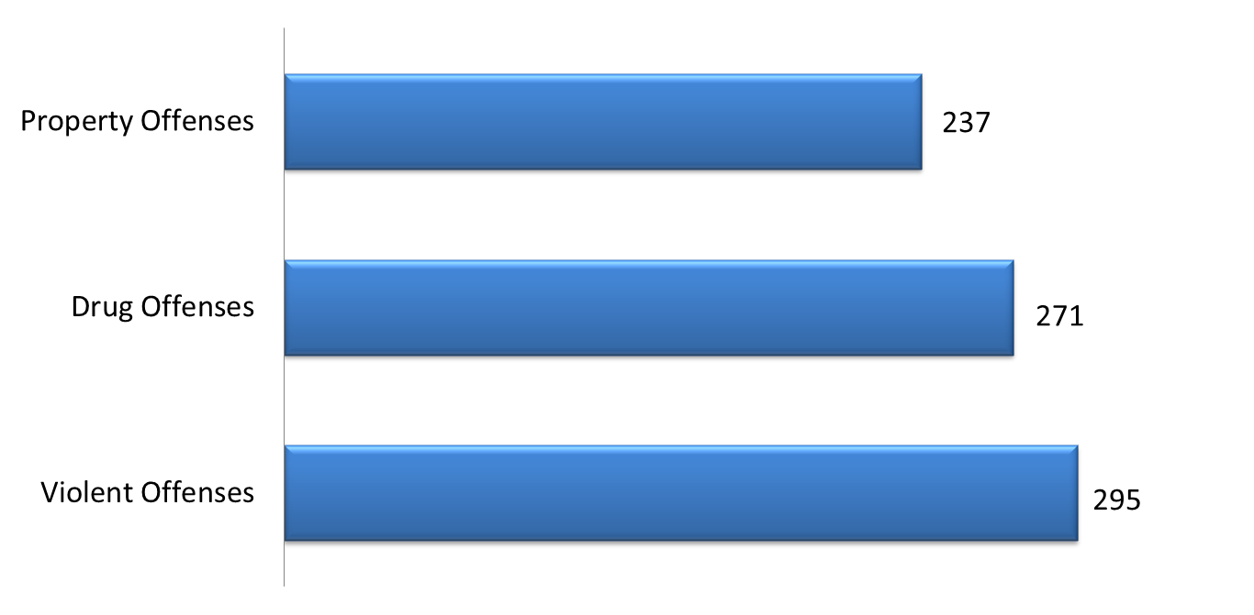
Median Number of Days between Arrest and Sentencing
(National Figures)
SWIFTNESS
Source: Rosenmerkel, S. P., Durose, M. R., & Farole, D. J. (2009). Felony Sentences in State Courts, 2006 - Statistical Tables. (NCJ No. 226846). Available at: www.bjs.org
11/07/26 | Illinois Criminal Justice Information Authority | <number>
Notes:
Swiftness generally refers to how quickly punishment can be done. Swiftness is important so that offenders understand and connect their behaviors to immediate consequences. Extending the length of time between when the offender and when the punishment occurs weakens the link between what the person did and the consequences of those behaviors.
What you see here are national figures of the timing from arrest to sentence. As you can see, the median days between arrest and sentence is over 6 months.

Slide 5
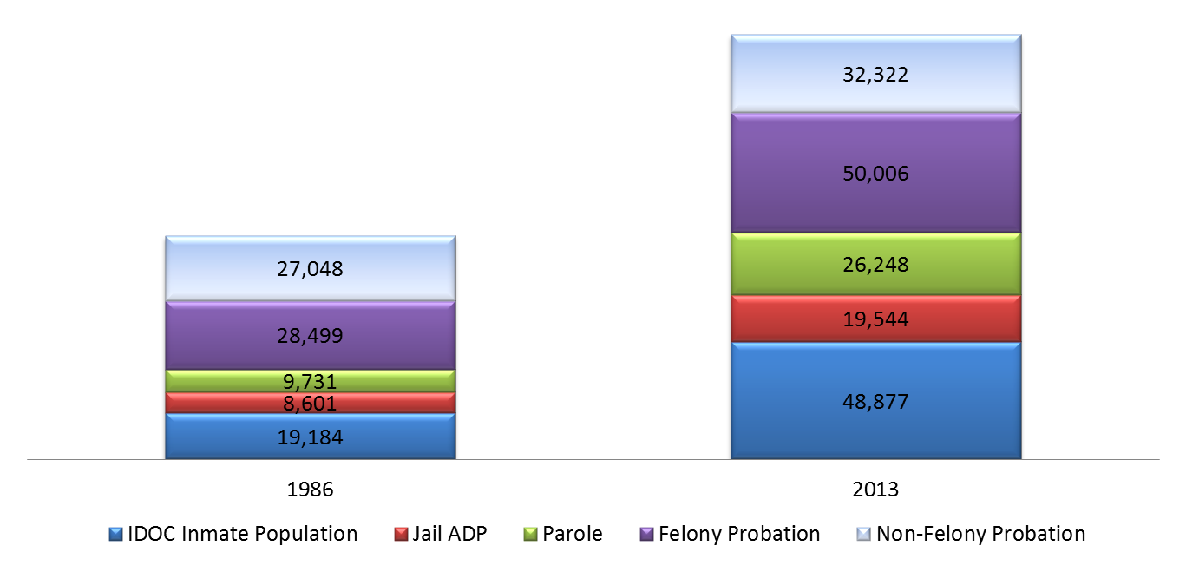
IL Adult Population under Correctional Supervision
SEVERITY
179,010
+5%
+55%
95,049
+138%
+101%
+125%
Source: IDOC and Parole populations– IDOC Research Unit; Probation caseload – AOIC Annual Report; Jail ADP – IDOC, Jail and Detentions Standards Unit Reports. 2013 Jail ADP based on the last reported year of data 2009
11/07/26 | Illinois Criminal Justice Information Authority | <number>
Notes:
Of the three different mechanisms severity is the easiest for the criminal justice system to control. As you have heard during many of the commission meetings, over the last few decades there have been various ways in which we have increased the severity of punishment. But generally, they can be grouped into two practices: increases in supervision and increases in the length of time supervised.
What you see here depicts how the correctional population has grown in Illinois. As this figure shows, not only have we increased our use of prison, and consequently parole, but we have also increased out use of jail and probation. In 1986, we had approximately 95,000 adults under some type of correctional supervision, whether in the community or in some type of institutional correctional facility. This represented 1.1% of the adult population. By 2013, we had 179,000 people under correctional supervision. This now represents nearly 2% or 1.8% of the IL population. The numbers you see on the side here are the percent change in the use of prison, jail, and community correctional options controlling for changes in the IL population. Again, we have not only increased our use of prison, but these other types of supervision too.
The increase in the use of supervision, whether it is institutional or in the community, matters because as Dr. Marlowe indicated in his presentation at a previous Commission meeting, over supervision is just as problematic as under supervision both for the offender, but also the associated costs. Moreover, simply shifting supervision from prison to community corrections does nothing to address the fact that we have also expanded the criminal justice system in other ways over the last few decades.

Slide 6
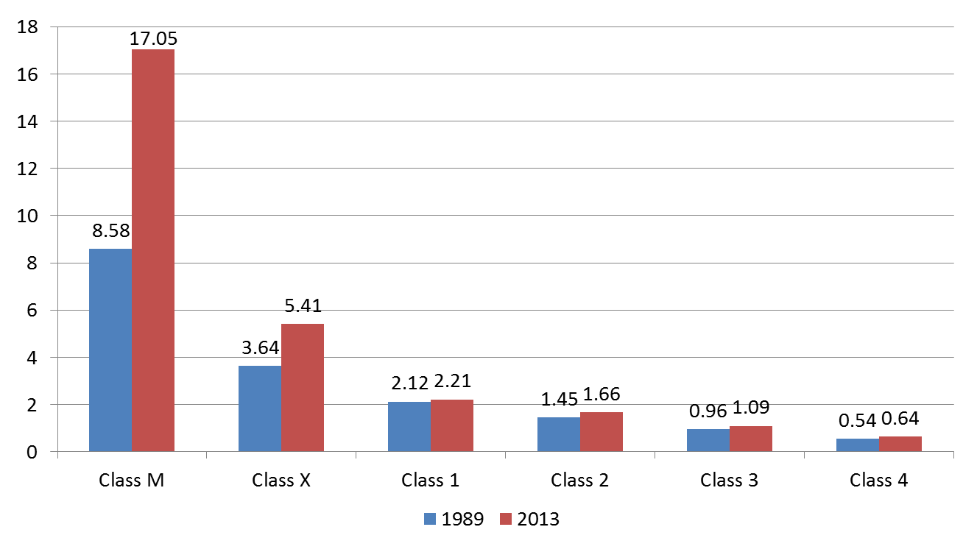
Average Length of Stay of Felons Exiting IDOC by Class
SEVERITY
Source: Averages exclude technical violations. SPAC analysis of IDOC administrative data.;
11/07/26 | Illinois Criminal Justice Information Authority | <number>
Notes:
As mentioned, we have also expanded length of time under correctional supervision. This increase can be attributed to increased sentence terms due to mandatory minimums, extended terms based on aggravating factors, and the effect of truth-in-sentencing laws, which require those convicted and sentenced to prison to serve 85% of their court-imposed sentence. Although many of those impacted by these are serious, violent offenders, even offenders who sentenced for lower level felonies have experienced longer lengths of stays due to the suspension of awarding meritorious and supplemental meritorious good conduct credits in 2009. And while it may seem like the increases are relatively small for some classes of offenses, particularly as compared to murder and class X felonies, it is important to remember even seemingly small increases over time for a large number of offenders can significantly increase the monetary costs of prison use.
So which matters most, certainty, severity, or swiftness? The answer is complicated and likely varies by offender and offense type. Individuals who are impulsive or risk taking may underestimate the probability they will get caught or may not consider or care about how severe the punishment might be. And while there is evidence that severity may have some deterrent effect, it is also the case that expanding the number of people who are subjected to supervision and for longer periods of time can both be harmful and costly. Expanding the number of people who are subjected to supervision, for instance, may decrease the stigma associated with the punishment. When punishment becomes a normal expectation of life, it may have less of a deterrent effect.

Slide 7
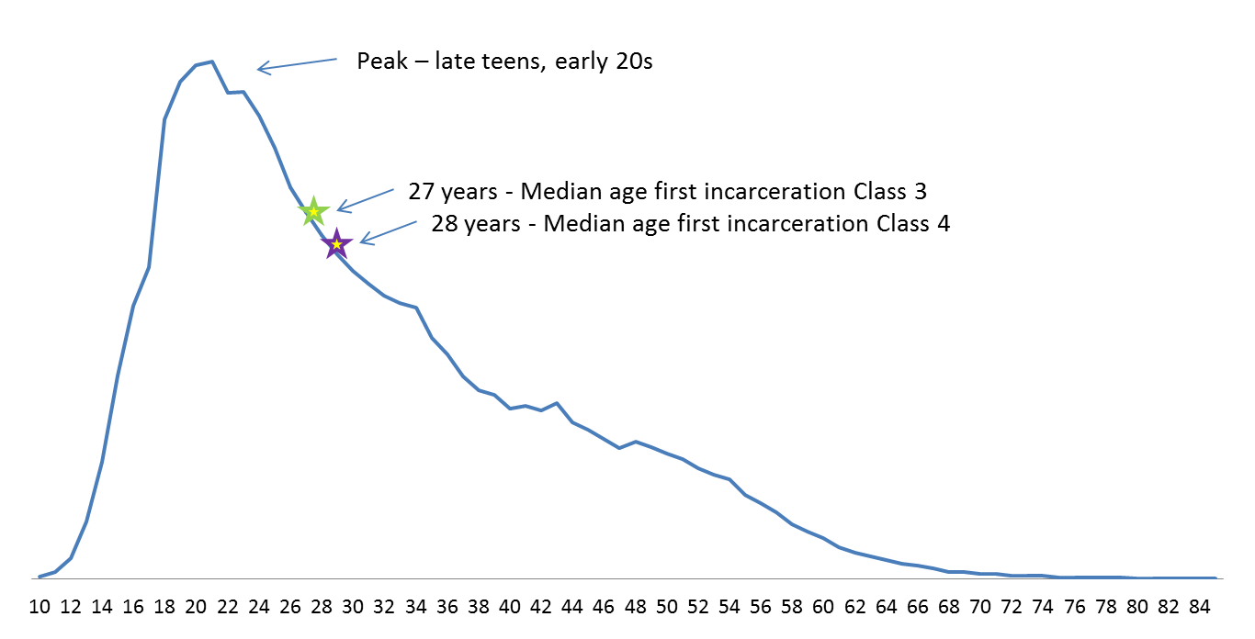
Illinois Age Crime Curve
INCAPACITATION
Source: Illinois State Police Criminal History Record Information (CHRI) System; IDOC administrative records.
11/07/26 | Illinois Criminal Justice Information Authority | <number>
Notes:
If we are not deterring, we are at least incapacitating. Here again, what we find is a complicated picture. What you see here is the age crime curve for Illinois based on criminal history data. The stars represent the median age of first incarceration for offenders sentenced for Class 3 and 4 felonies. As you can see, it is well after the crime peak. So basically, individuals are being sent to prison well beyond the age that offenders start to desist from crime. So lengthening sentences for these and other lower risk offenders has diminishing returns. In other words you are actually getting less for the money you are spending.

Slide 8
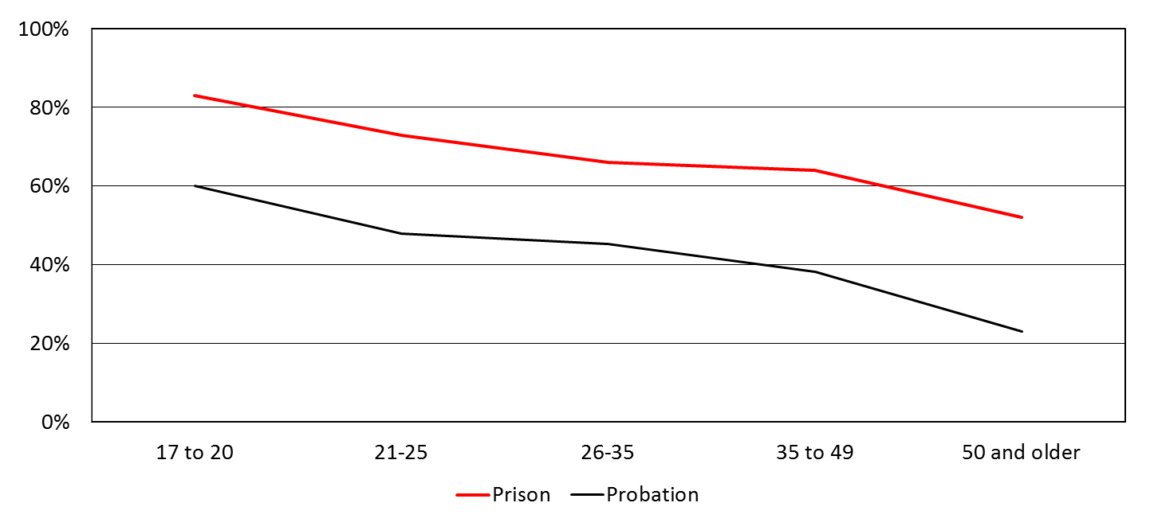
Age-Specific Rearrest Rates Among Cohort of
IDOC & Felony Probation Exits, 3 years Post-release
INCAPACITATION
Source: Chart provided by Dr. David E. Olson. Analyses by Dr. Olson of data from the study of offender recidivism by Olson, Stalans & Escobar. Data provided by IDOC’s Planning and Research Unit and analyses of data collected by the Illinois Administrative Office of the Illinois Courts’ 2000 Probation Outcome Study
Notes:
Considering the previous slide, one might conclude that it may be beneficial to incarcerate earlier in an offender’s career. However, research is unclear about whether prison would actually create benefit of this type, and in fact some evidence suggests the costs would outweigh the benefits. As shown here, recidivism rates for offenders sentenced to probation tend to be lower than those sentenced to prison. Additionally, imprisonment, particularly during formative years, may interfere with or halt important life events that have been shown to protect offenders from engaging in future criminal behavior. This includes earning a degree, obtaining full-time employment, and entering and maintaining healthy supportive relationships.
Just to be clear, incapacitation through incarceration has moderately impacted crime rates, but like deterrence how this works is complicated. Incapacitation is not a zero sum game—arresting and incarcerating one offender is not guaranteed to result in a decrease of one crime. Just like deterrence, incapacitation’s effect likely varies by offender and offenses. For some crimes, like those that involve groups, incapacitating one offender does not necessarily reduce crime as other members of the group can continue to engage in those activities. Other types of crimes, like drug crimes, have an never ending supply of potential offenders willing to replace those that are removed.
Just like deterrence, what we can conclude that while incarceration does have an impact, it is likely moderate, which is why it is important to begin thinking about our current policy practices how much impact they will have in relation to their associated costs.

Slide 9
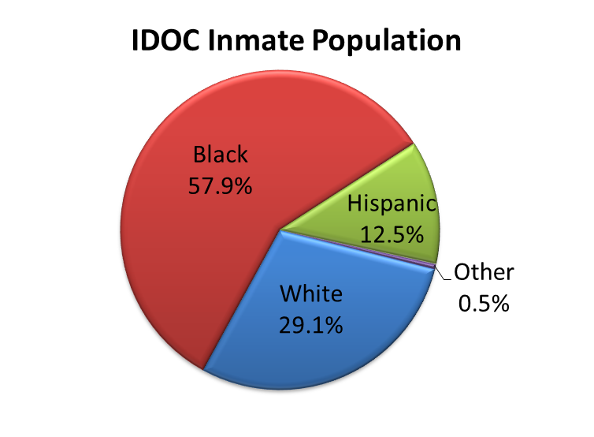
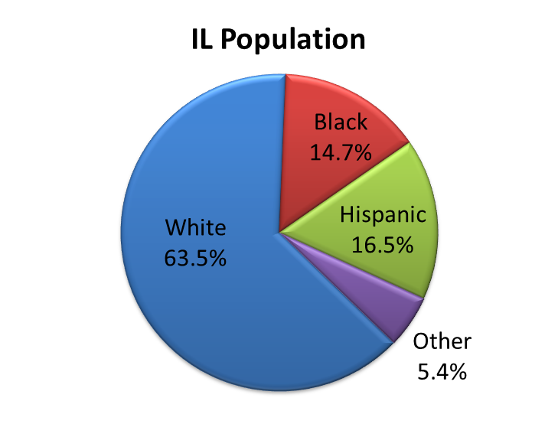
IDOC Inmate Population and IL Population Characteristics
IMPACT
Source: Inmate figures: IDOC administrative records; IL Population figures: US Census Bureau.
11/07/26 | Illinois Criminal Justice Information Authority | <number>
Notes:
And part of weighing the costs of how we currently do deterrence and incapacitation includes considering how current practice has negatively and disproportionately impacted black communities in IL.
As John mentioned, our focus on increasing severity and the use of supervision reflects a real, historical concern about violent crime. It also represents a tangible way to show that the criminal justice system is being responsive to communities. However, long-term, overreliance on formal controls through increases in severity and incarceration to achieve moderate amounts of deterrence and incapacitation has consequences for individuals, family, neighborhoods, and the criminal justice system.

Slide 10
Collateral Consequences
IMPACT
Individuals
Employment
Licensing
Government loans and grants
Housing
Education
Families and Communities
Parenting/Family functioning
Child Functioning
Marriage/Intimate relationships
Community well-being (human capital, social capital)
Source: American Bar Association. National inventory of the collateral consequences of conviction. http://www.abacollateralconsequences.org/
Clear, T. (2007). Imprisoning communities: How mass incarceration makes disadvantaged neighborhoods worse. New York, NY: Oxford University Press.
11/07/26 | Illinois Criminal Justice Information Authority | <number>
Notes:
These costs are more than just the amount of funding it takes to incarcerate or supervise offenders. It also includes consequences for individuals under correctional supervision and, importantly, many of these costs extend beyond the original punishment/sentence to include life altering implications for individuals as well as families and communities.

Slide 11
SUMMARY
Deterrence has limitations, particularly as currently practiced
  Many crimes go unreported, even fewer result in arrest and conviction (certainty)
  Case processing takes time, particularly as the system has expanded (swiftness)
  Punishment has increased (severity), but so too has net widening and the deepening of involvement in the criminal justice system; more people are in contact with the system and for longer
While incarceration likely has a moderate impact on crime (incapacitation), mass incarceration produces diminishing results at significant $$$$
Deterrence and incapacitation are complicated
  Vary by offender and offense
  How we do deterrence and incapacitation must involve a consideration of the costs associated with the benefits gained
Increases in supervision and incarceration has consequences for individuals, families and communities
  At risk is the perceived legitimacy of the criminal justice system
11/07/26 | Illinois Criminal Justice Information Authority | <number>
Notes:
In summary. . . .

